Slide 1
Image Search - CBIR
Comparing performance and accuracy of different Image Search Techniques
Yasser Amr Salem

Slide 2
Flow Chart of how the code goes
Extract Features
Save CSV
ImageName, FeatureVector
Extract query Image Feature
Display Images
Get top 5 closest images
Euclidean and Cosin
Calculate distance between query image and all images

Slide 3
5 different Approaches
Traditional Feature Extraction
Color Histograms
Local Binary Patterns (LBP)
Histogram of Oriented Gradients (HOG)
Deep Feature Extraction
ResNet
Text as a Feature

Slide 4
Encountering Problems
SIFT (Scale-Invariant Feature Transform)
ORB (Oriented FAST and Rotated BRIEF)
The problem in both these approaches is that it’s not contestant
2 problems were encountered while using these approaches:
Not all Images have extract the same number of key points
Sometimes there might be no key points detected in the image

Slide 5
The key attribute (used in accuracy evaluation) for each image is obtainedfrom the folder in which the image belongs, and can also be identified fromthe filename -- <categ_name>/<categ_name>_XXXX.jpg.

Slide 6
Evaluation: Color Histogram

Slide 7
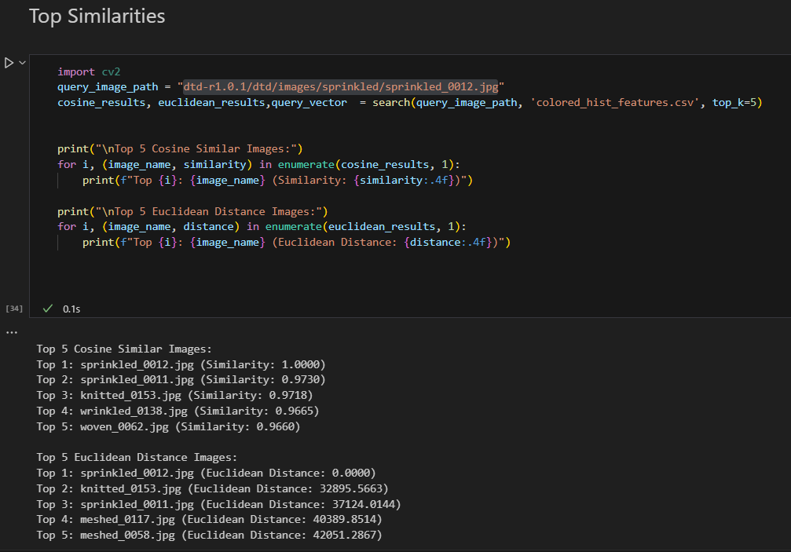
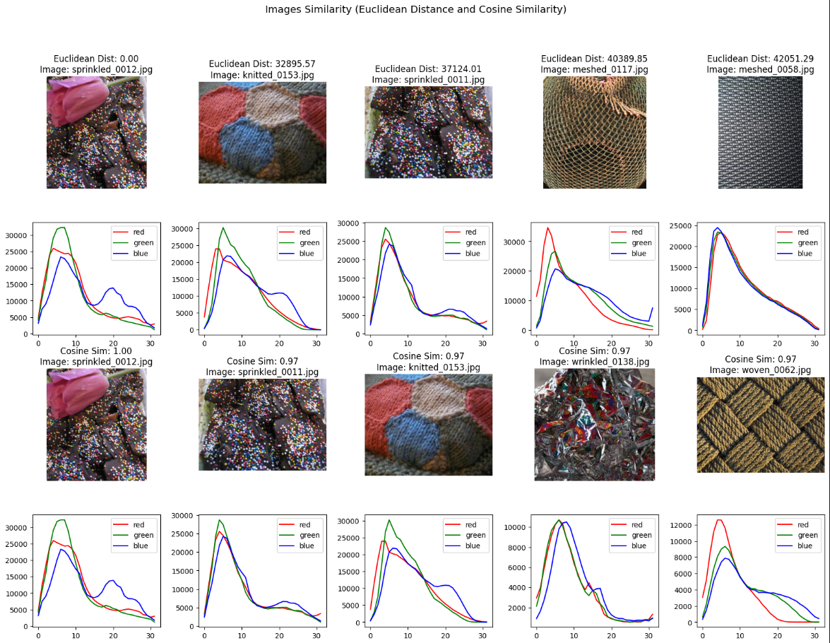
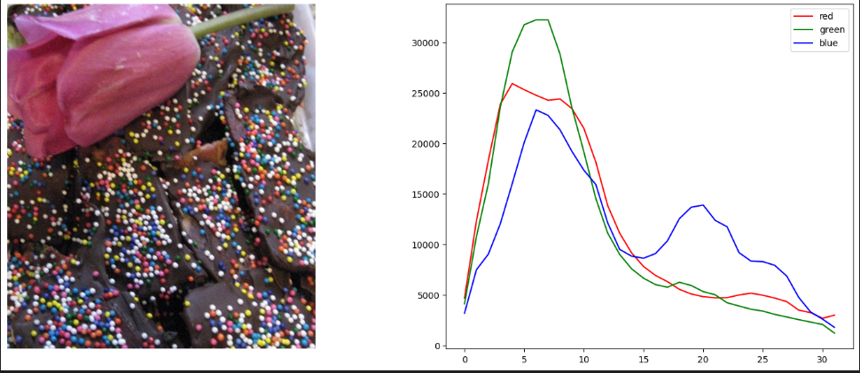

Slide 8
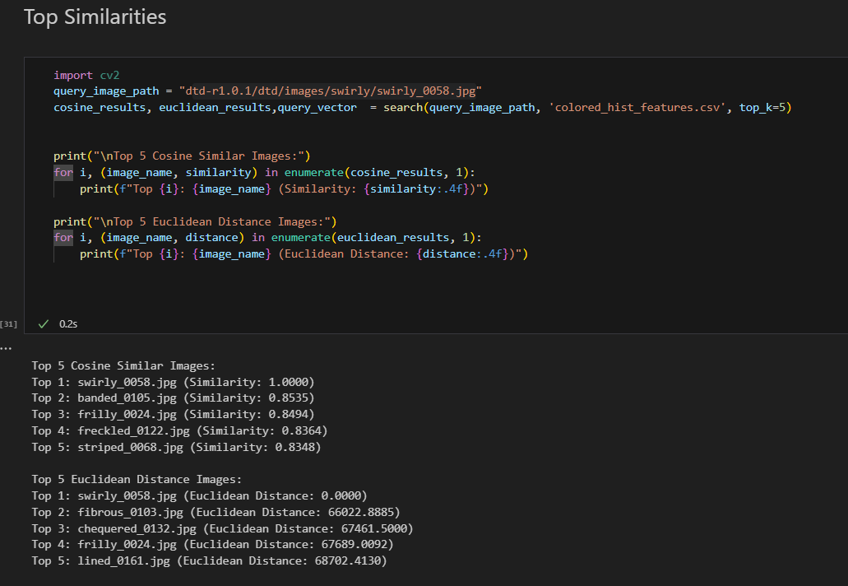
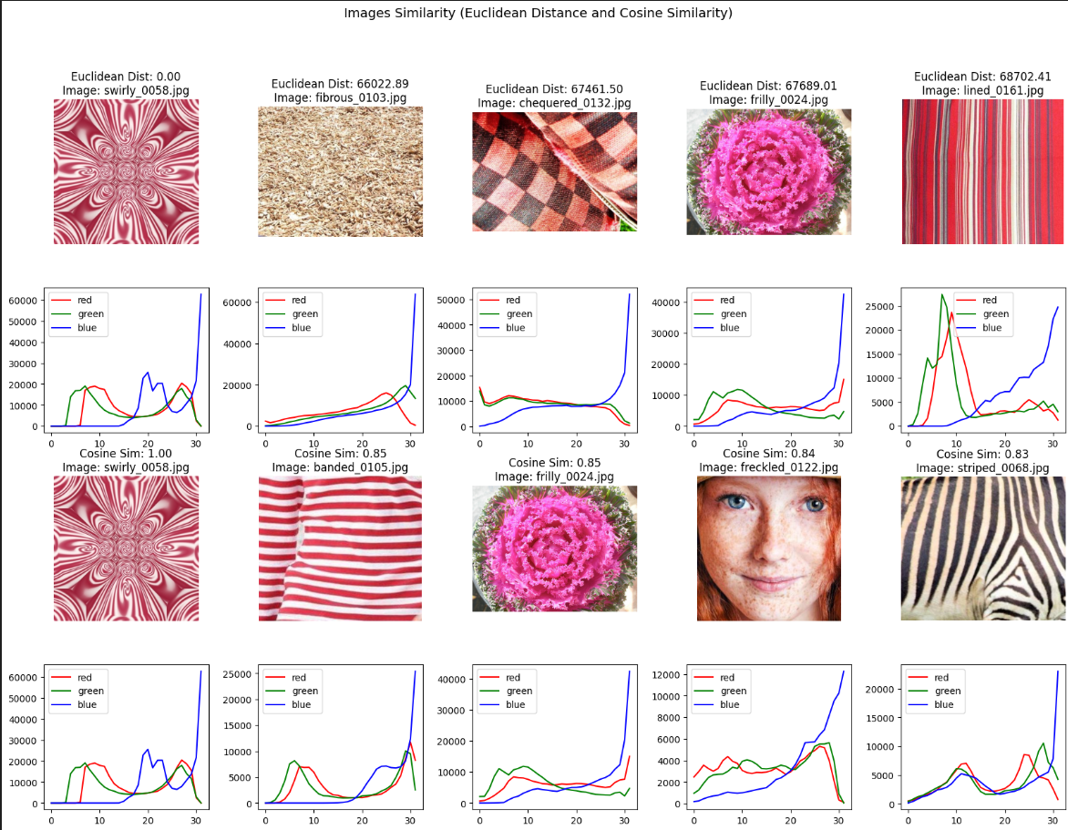
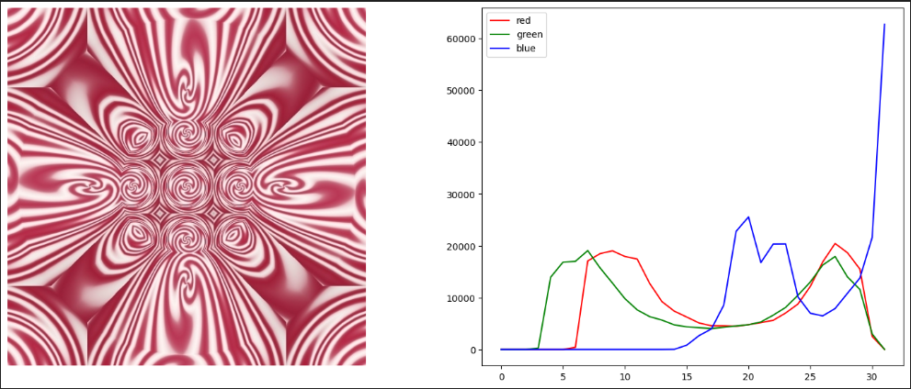

Slide 9
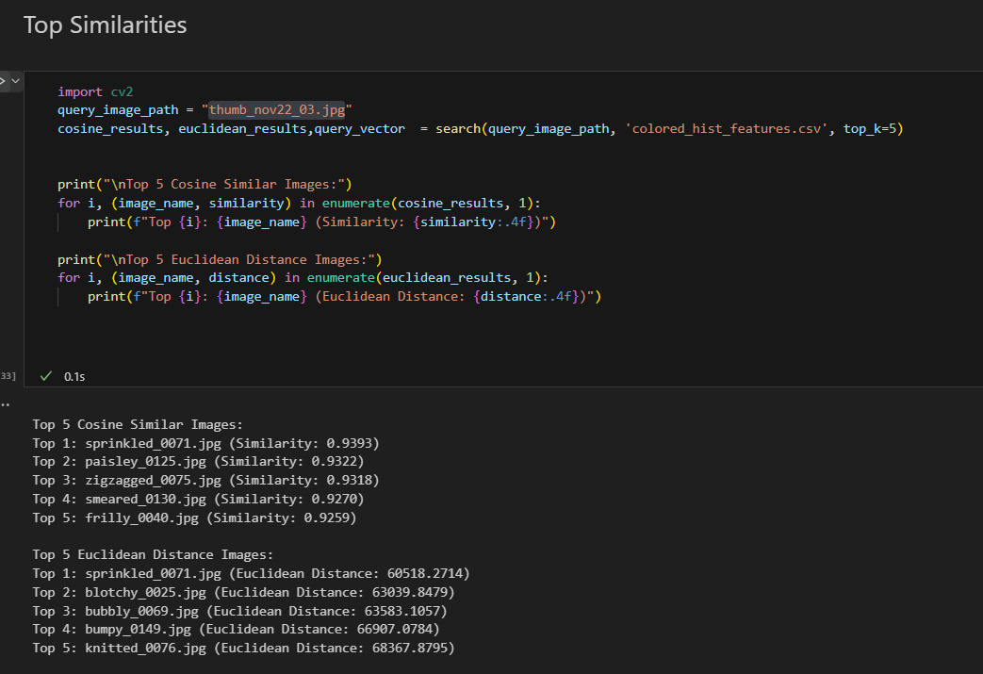
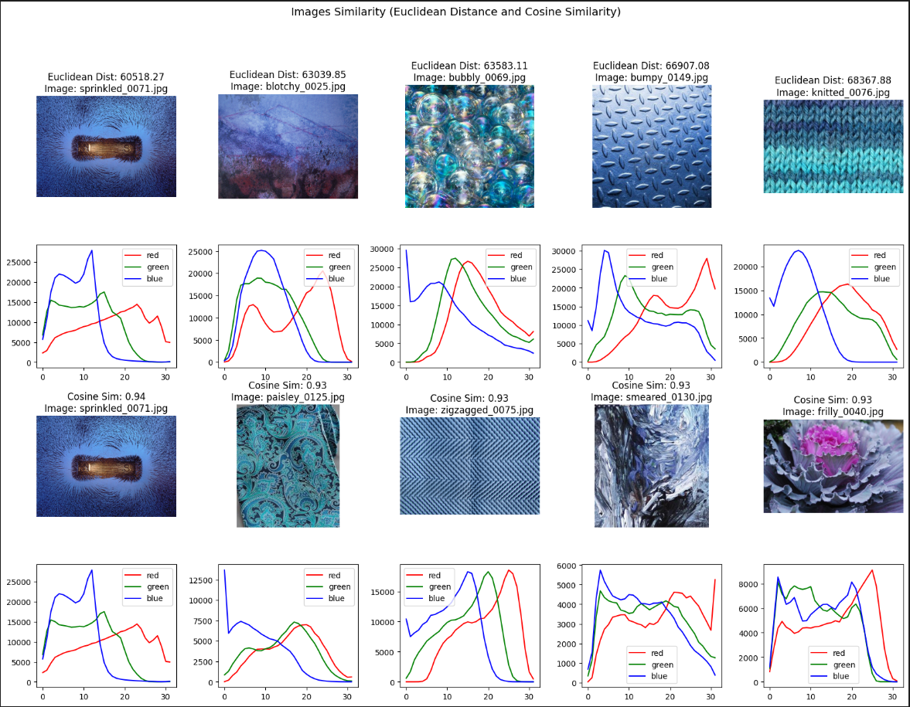
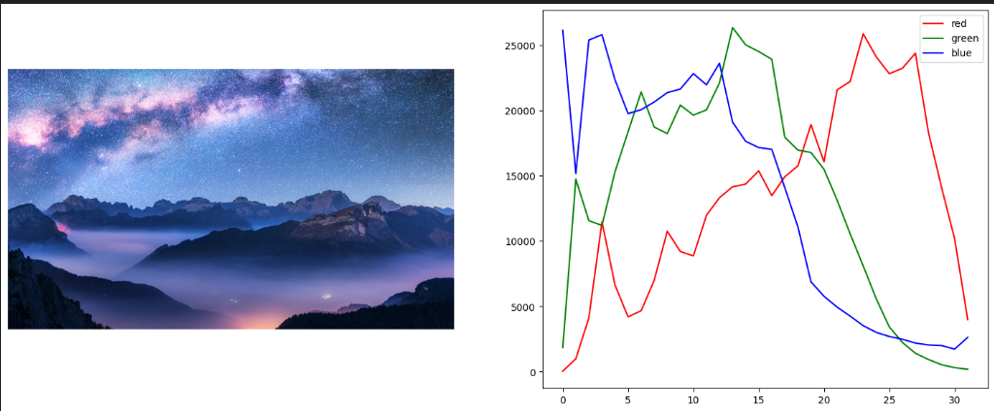

Slide 10
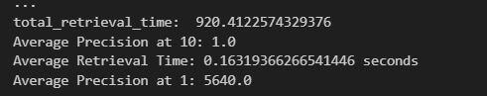
Scores
Precision at 1: 1.0
Precision at 10: 1.0
Retrieval time: 0.18139869583413956 seconds

Slide 11
Evaluation: Local Binary Patterns (LBP)

Slide 12
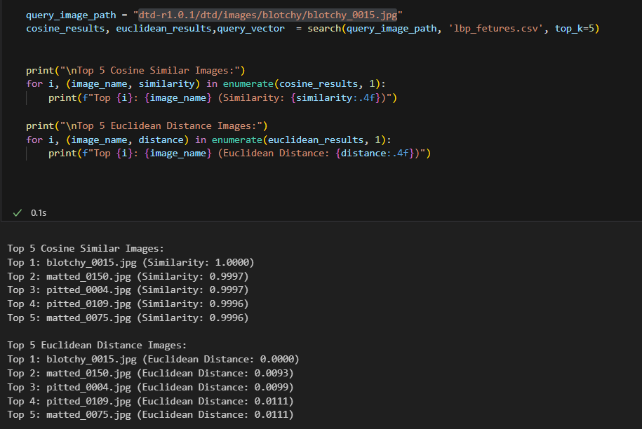
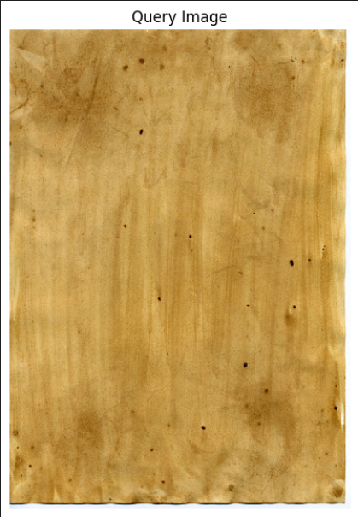
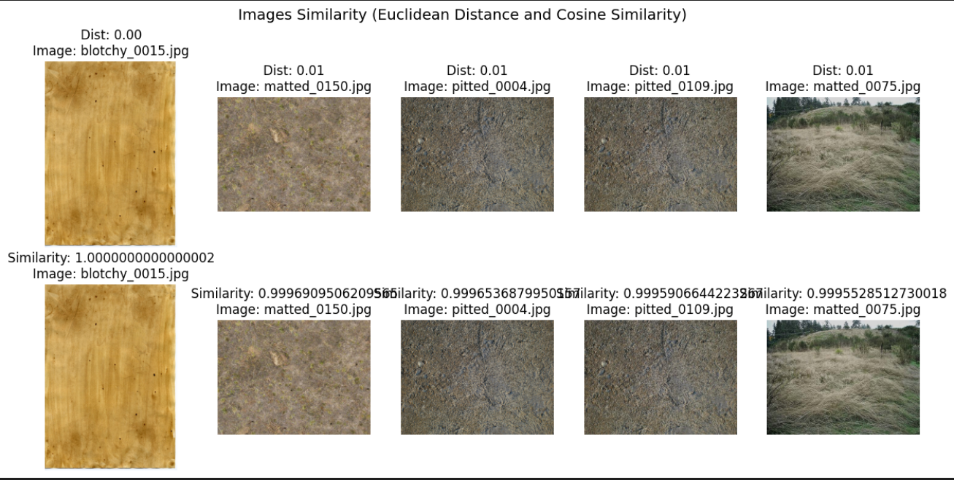

Slide 13
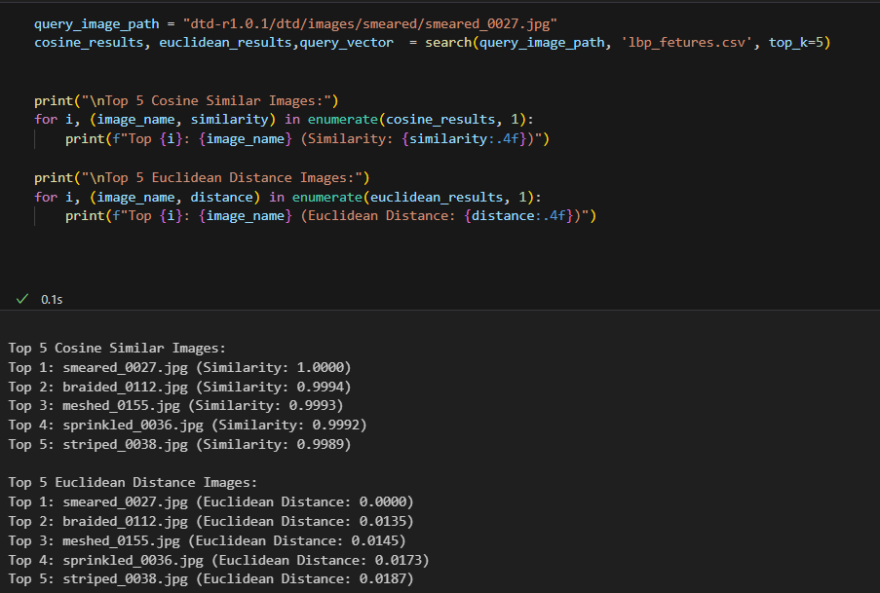
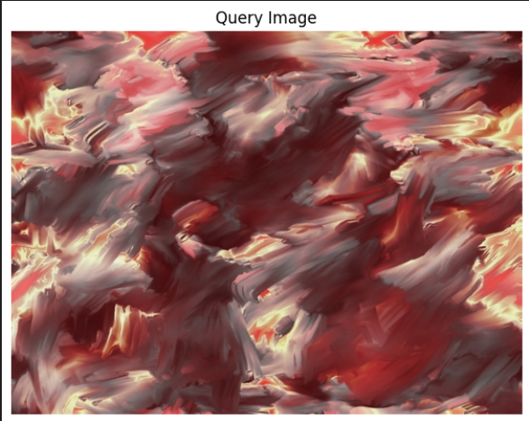
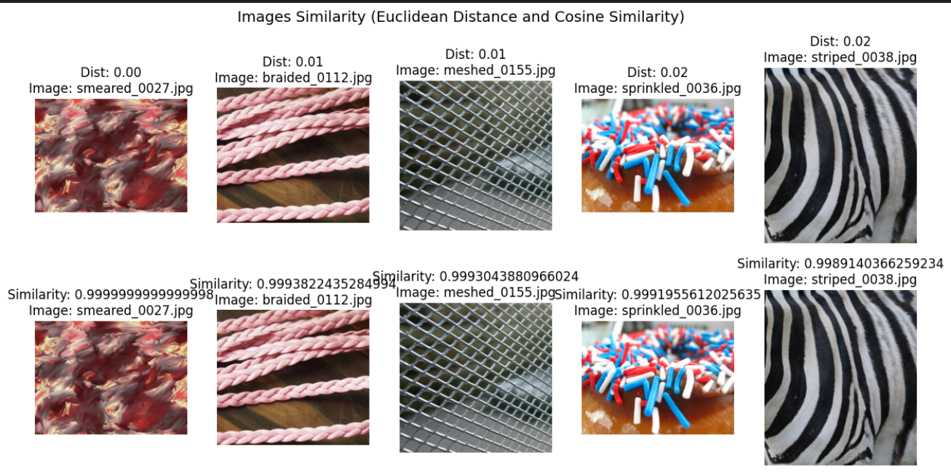

Slide 14
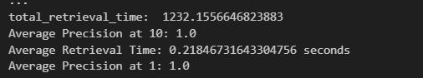
Scores
Precision at 1: 1.0
Precision at 10: 1.0
Retrieval time: 0.218467316 seconds

Slide 15
Evaluation: Histogram of Oriented Gradients (HOG)

Slide 16
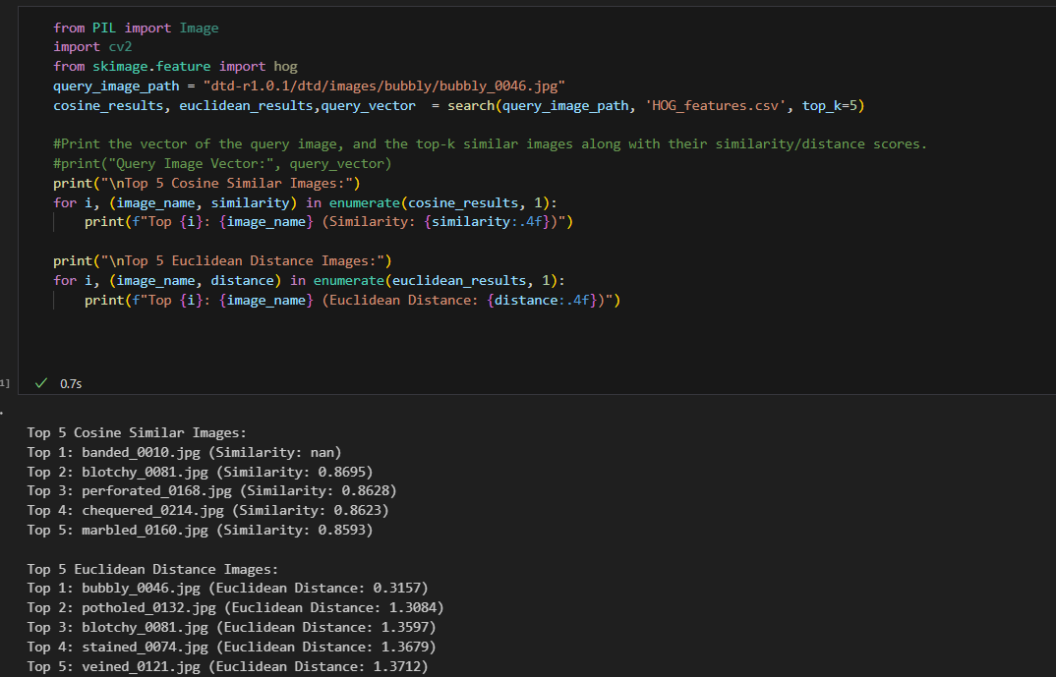
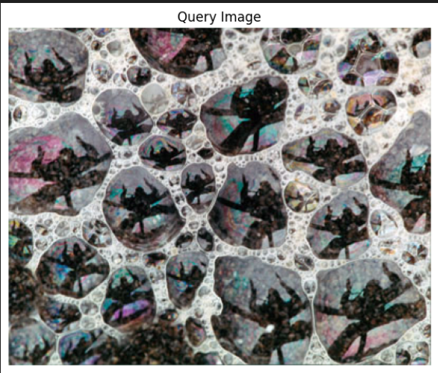
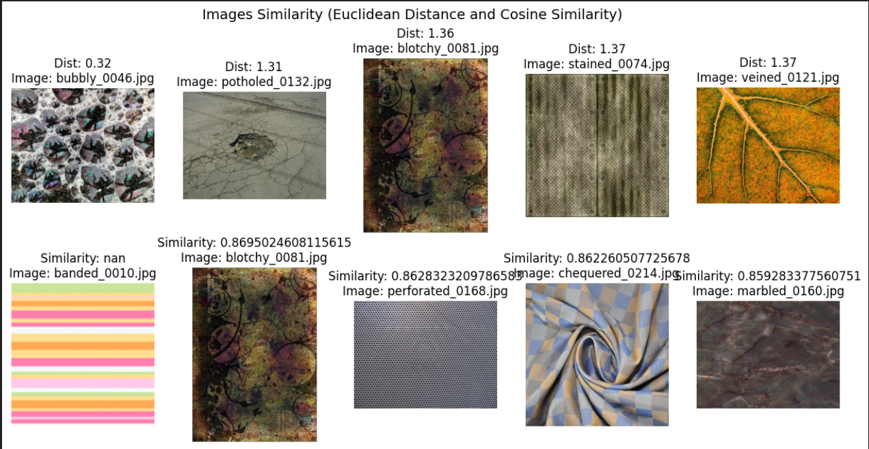

Slide 17
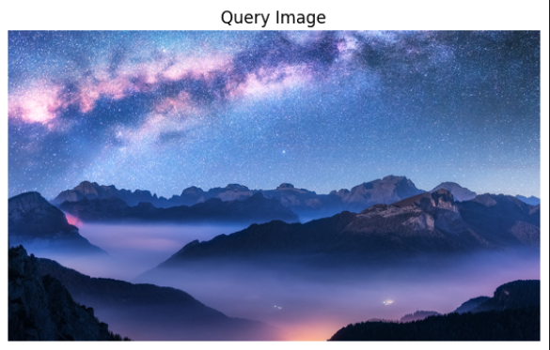
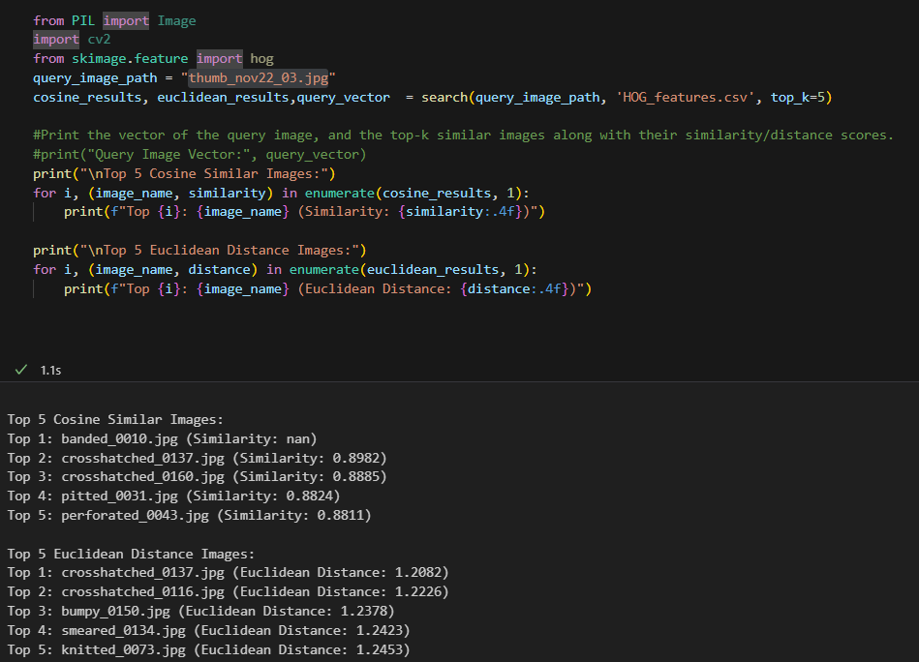
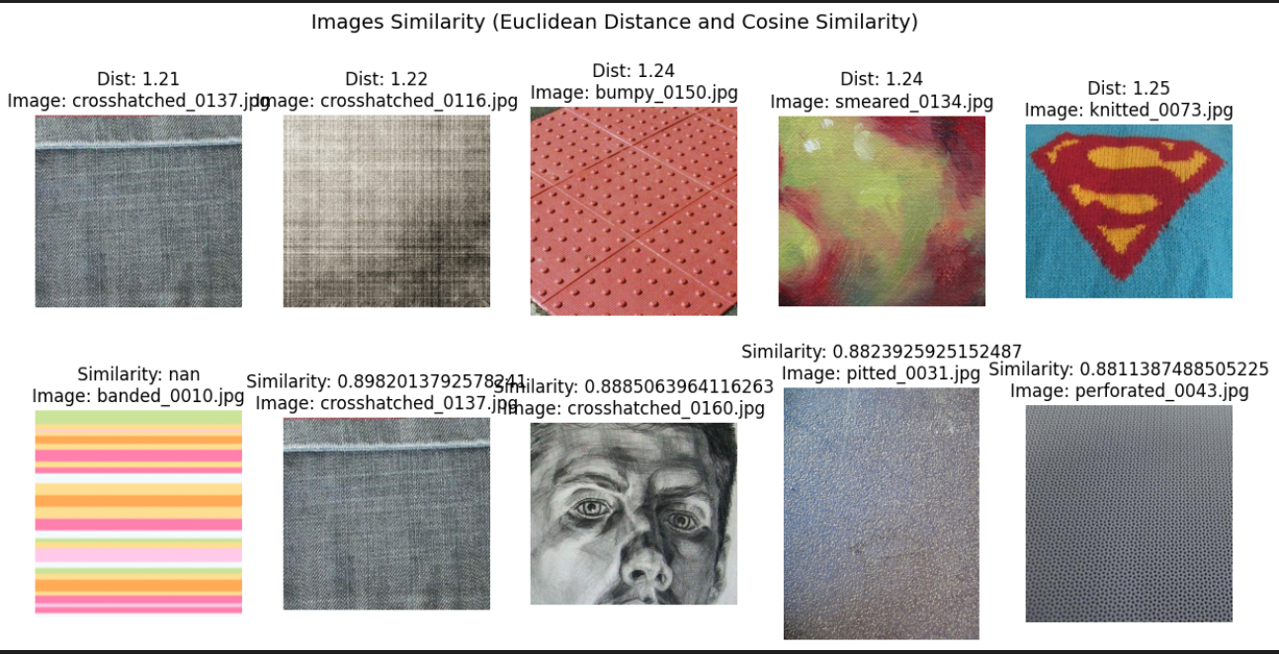

Slide 18
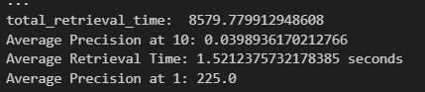
Scores
Precision at 1: 255/ total Images
Precision at 10: 0.0398936170212766
Retrieval time: 1.5212375732178385 seconds

Slide 19
Evaluation: ResNet

Slide 20
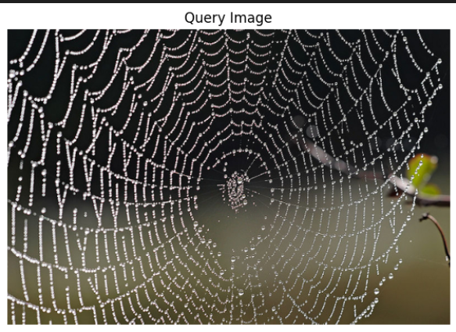
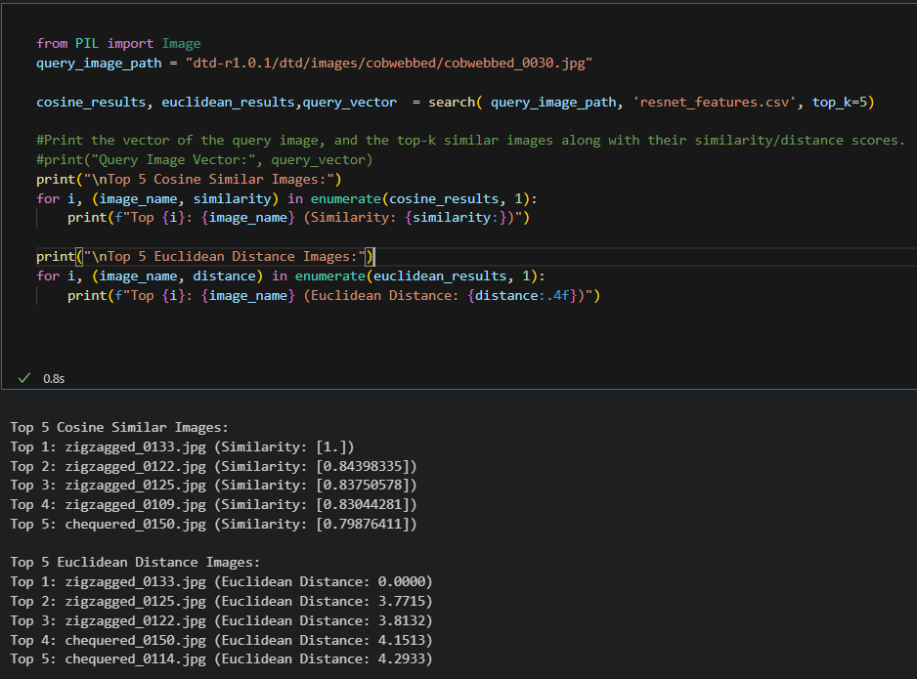
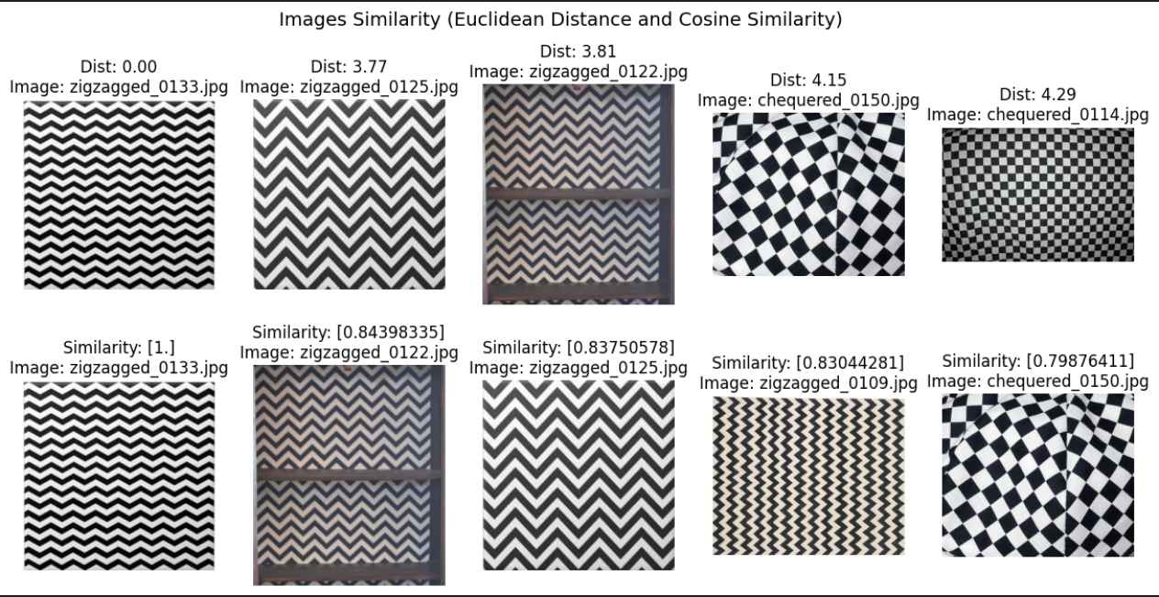

Slide 21
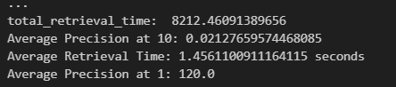
Scores
Precision at 1: 120 / total Images
Precision at 10: 0.02127659574468085
Retrieval time: 1.4561100911164115 seconds

Slide 22

PCA

Slide 23
Evaluation: Feature Combination

Slide 24
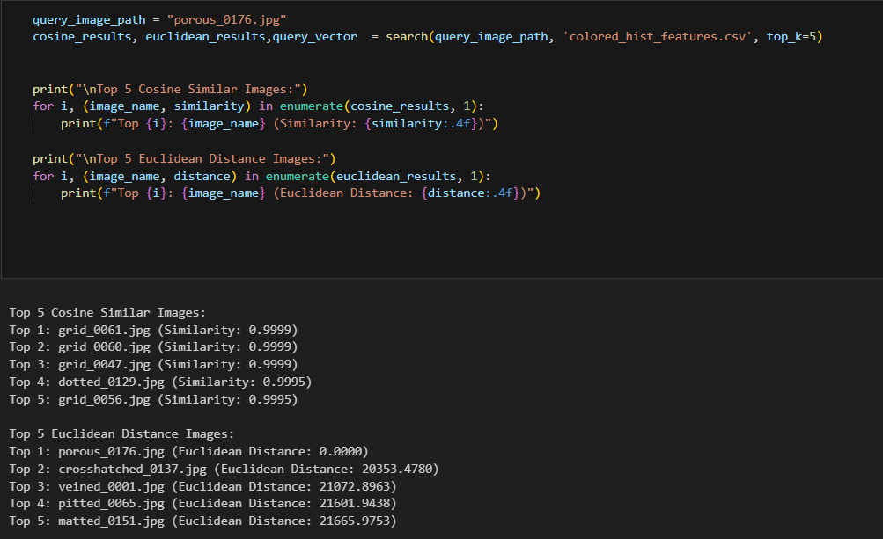
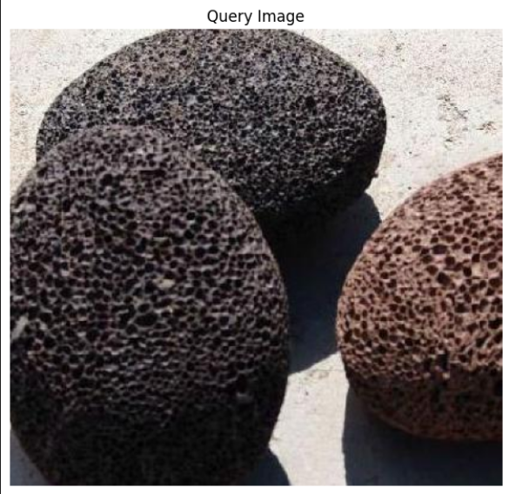
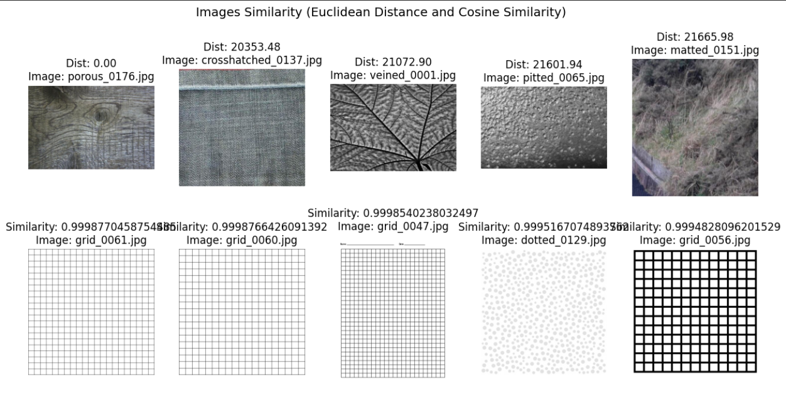

Slide 25
Text as a Feature: Clip-retrival

Slide 26
Approach
Just like all the previous techniques, in this technique we also extract a feature vector for each image.
The difference is, the feature vector is extracted from the CLIP pretrained model, which is used to describe what is seen in an image.
This is one of the unique approaches in image search it Focuses on the semantic point of view of the image

Slide 27
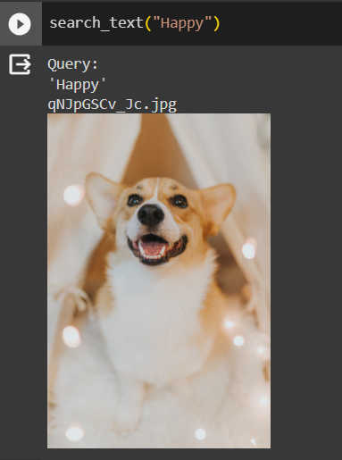
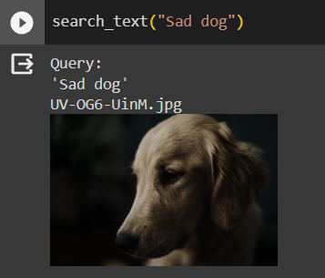
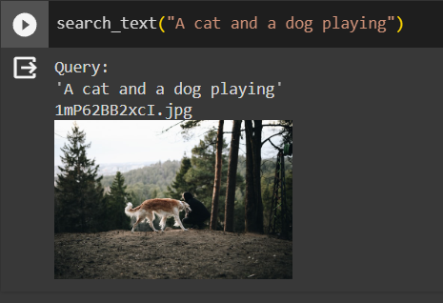
Searching for an Image using a string

Slide 28
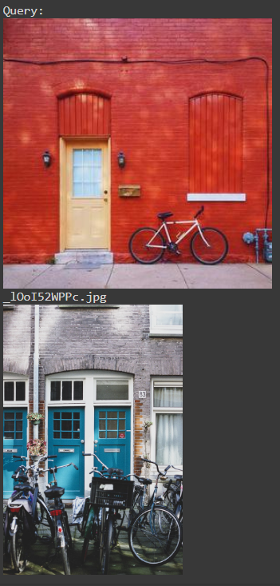
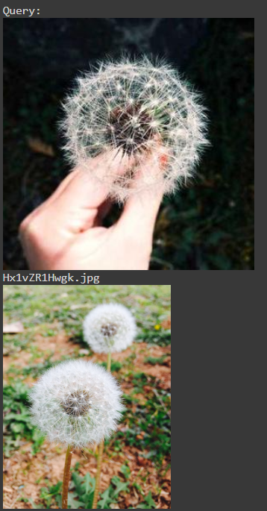
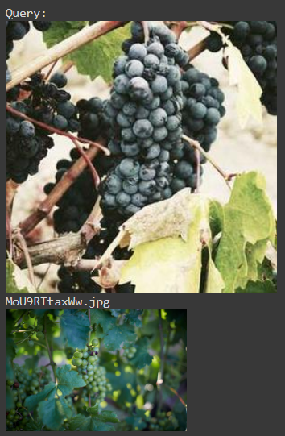
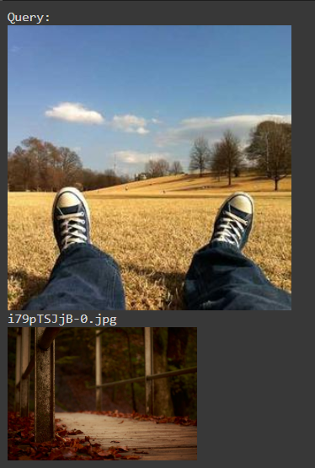
Searching for an image using an image

Slide 29
https://huggingface.co/spaces/marcelcastrobr/CLIP-image-search

